Slide 1

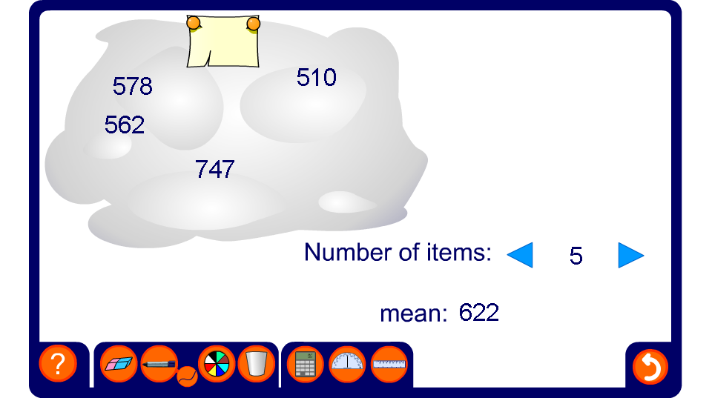


Calculating a missing data item
Notes:
Pupils could hide one of the numbers in their own cloud, and have a partner work it out.

